Slide 1

Power BI Quick Start #2 E01
February 8, 2021

Slide 2
Power BI Quick Start #2 E01
1
Power BI Course introduction
2
Power BI desktop Installation
3
Data Transformation
4
Practice

Slide 3
Power BI desktop introduction

Slide 4
Power BI desktop introduction
Git Hub Repository: https://github.com/AndreyQC/MSBI.Lab Homework: Folder Lab; Deadline: Until next Lecture; Done files: Git.Epam.Com
Go to https://git.epam.com and create git project with name (Power-BI-Quick-Start-FirstName-LastName). Add all trainers to you GIT project as masters (anna_sedina@epam.com, darya_pivikova@epam.com, elisey_astakhov@epam.com). Or add darya_pivikova@epam.com.
Marks: andreypotapov.database.windows.net/MSBIAzure
Status meeting: every Tuesday – 19.00 – 19.30
Video: https://videoportal.epam.com/channel/MKBYbl57Xq/videos
MS Power BI: https://www.youtube.com/playlist?list=PL1N57mwBHtN0JFoKSR0n-tBkUJHeMP2cP

Slide 5
Power BI Installation

Slide 6
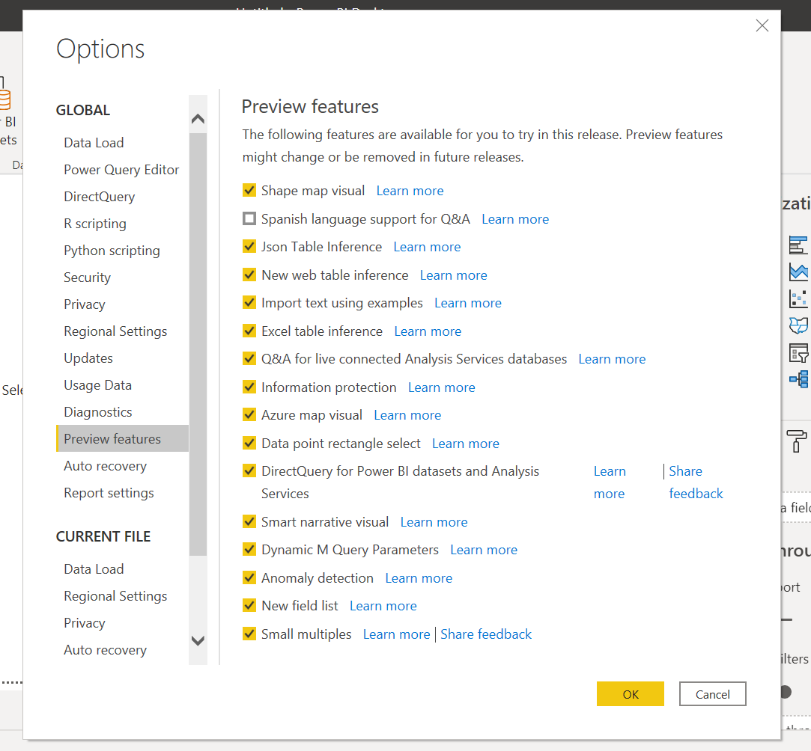
Power BI Installation
Install Power BI Desktop: https://www.microsoft.com/en-us/download/details.aspx?id=58494
Language: English;

Slide 7
Data Transformation

Slide 8
Data Transformation
Data Sources
Advanced Editor;
Rename Query
Duplicate column
Change data type
Work with date;
Split column;
Create groups and queries;
Create new columns:
Conditional column;
Column from Example;
Custom column;
Index column;

Slide 9
Data Transformation
Load data from folder;
Append queries;
Custom column;
Merge queries;
Query dependences;
Load excel file;
Query parameter;

Slide 10
Practice

Slide 11
Data Transformation
Create function with parameter;
Invoke custom function;
Pivot/unpivot data;
Filtering out values;
Replacing data;
Create new query by list of values;
Enter data in new query;
Create new query by column from another;
Working with duplicates;
Working with fact and dimensions;

